Slide 1

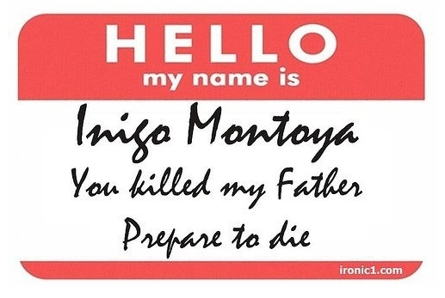
Naming things is hard

Slide 2


Slide 3
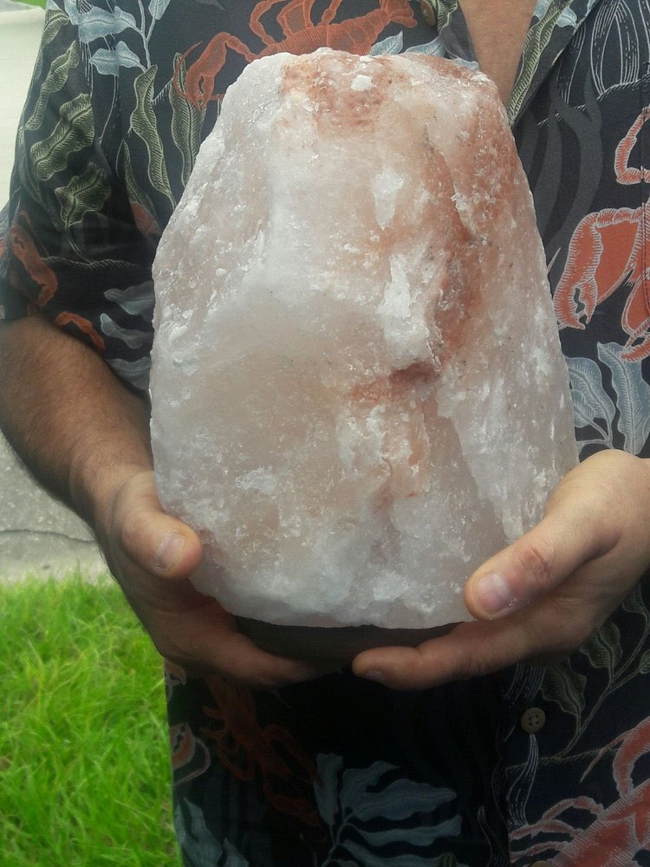
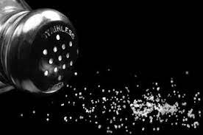
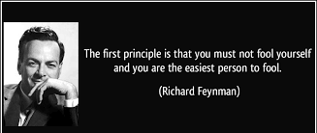
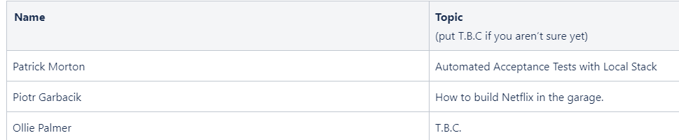
Naming things is hard
float currentx1ToTopVertDist = getDistBetweenTwoPoints(
triVert1,
CanvasPoint(currentx1, scanlineY)
);
/* trivial case of bottom-flat triangle */
float bottomFlatTopToBottomInvSlope … ;

Slide 4



Content has been stolen borrowed from this very useful article:
“Ten Commandments For Naming Your Code” – Matthew Jones
Condensed & informative

Slide 5
Rule #1 Thou shalt be specific.
Naming a baby
John
John Smith
X Æ A-12

Slide 6
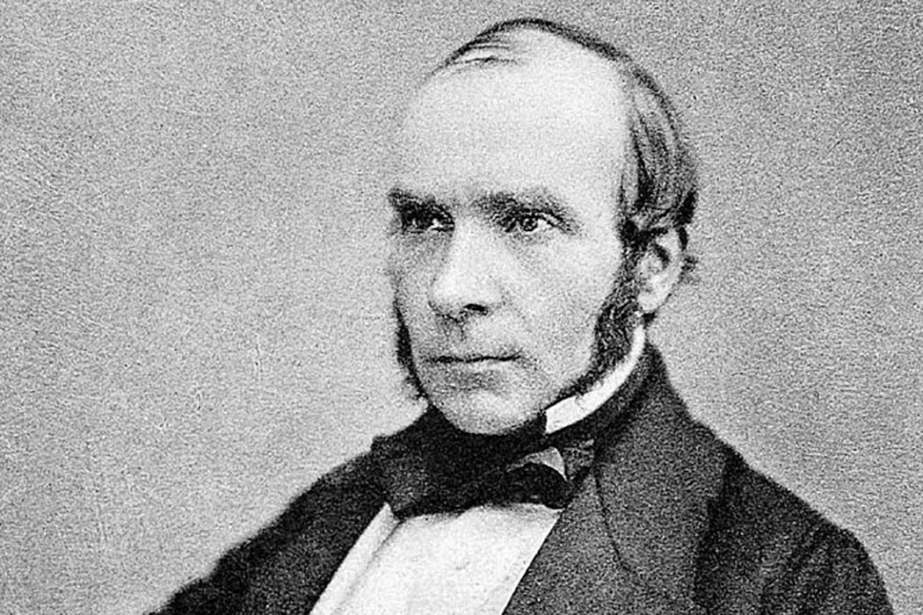

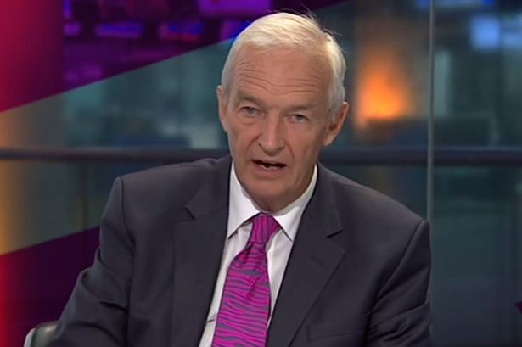
Rule #2 Thou shalt not use unnecessary words.
Context matters
JonSnowPresenter
JonSnowGameOfThrones
- JonSnowWhoKnowsNothing
JonSnowEpidemiologist
JonSnow

Slide 7
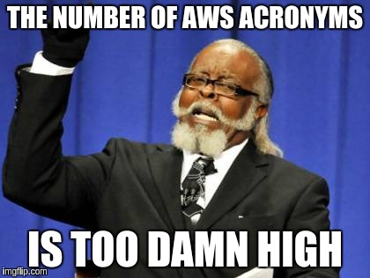
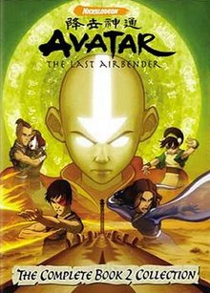
Rule #3 Thou shalt not use abbreviations.
XNA
ADR
TLA
XNA’s Not Acronymed
Architectural Decision Record
American Depository Receipt
Accord européen relatif au transport international des marchandises Dangereuses par Route
Three-Letter Abbreviation
Three-Letter Acronym
Term Loan A
Text Link Ads
The Last Airbender
TSNUA
Time Sensitive Networking with Unified Architecture
Thou Shalt Not Use Abbreviations

Slide 8

Biology Throwback
“
”

Slide 9
Rule #4 Thou shalt use the code's primary human language.
Saluton mondo!
你好世界！
こんにちは世界！
Ciao mondo!
Привет мир!
Olá Mundo!
مرحبا بالعالم!
Hej världen!

Slide 10

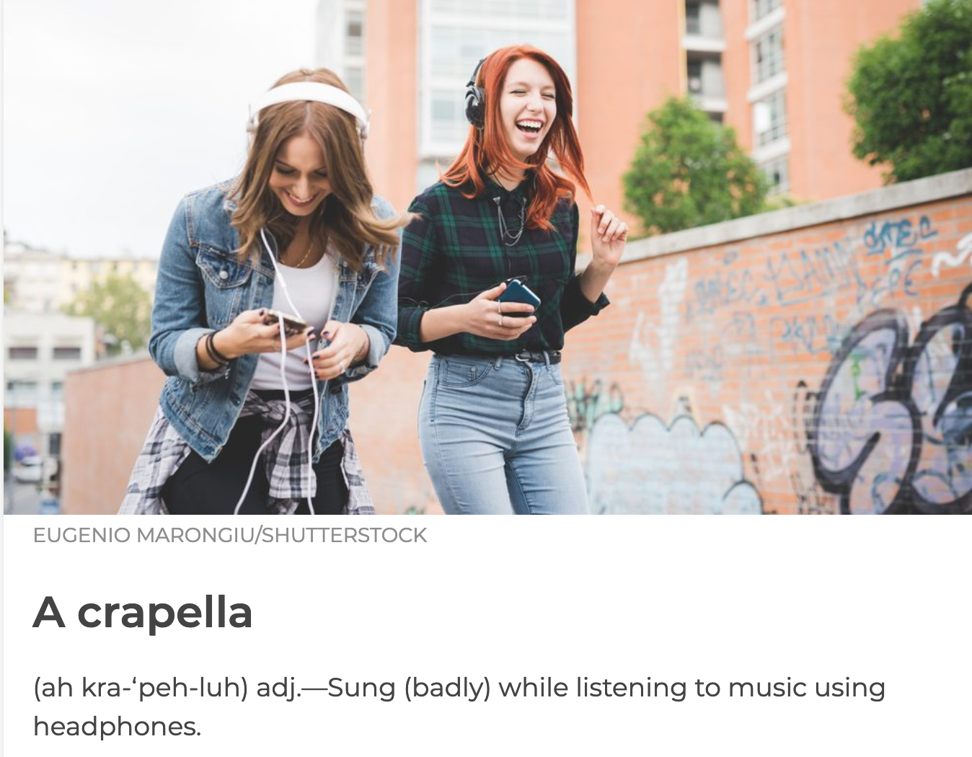


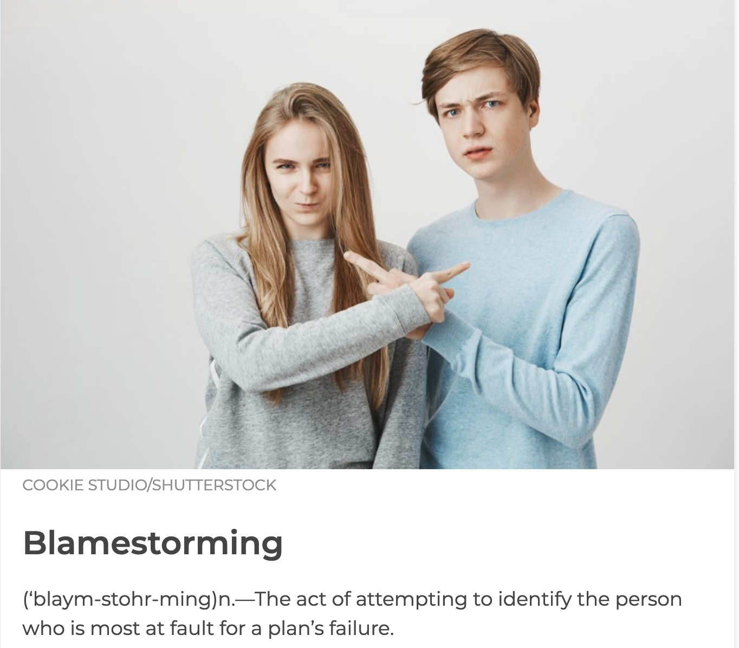
Rule #5 Thou shalt not make up words.

Slide 11
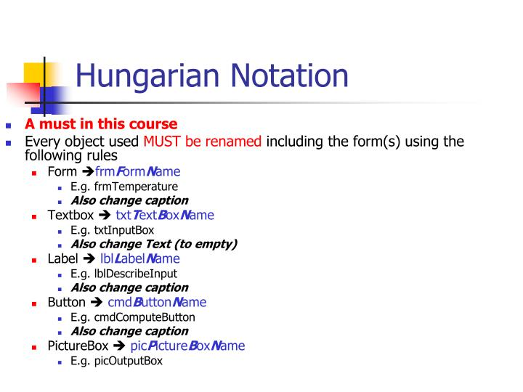
Rule #6 Thou shalt not include type.
strName = “Ollie”
arru8NumberList = […]

Slide 12

Rule #7 Thou shalt only use non-obvious words if the meaning is obvious.
Non-hyphenated
for(int x = 10; x >= 0; x--)
for(int greenBottles = 10; greenBottles >= 0; greenBottles--)
Phonetic
Hippopotomonstrosesquippedaliophobia

Slide 13
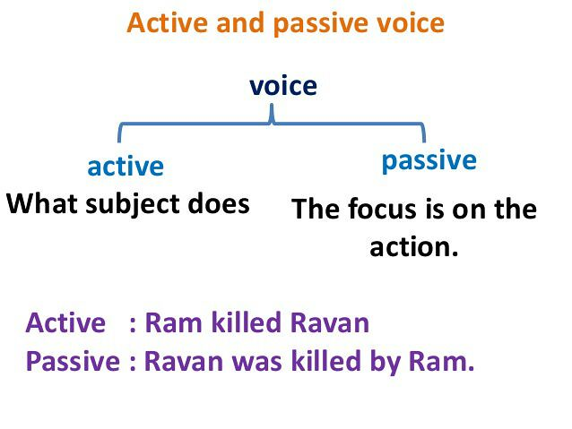
Rule #8 Thou shalt prefer active voice.
Active voice shows that an action is being done by an object
GetTranspilation()
Transpile()

Slide 14
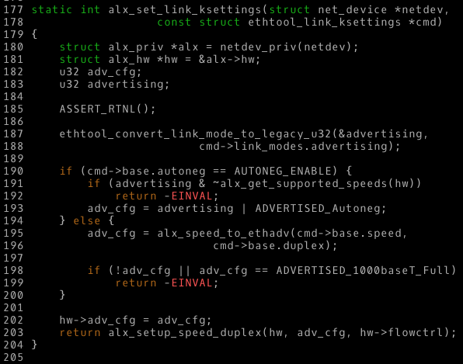

Rule #9 Thou shalt use consistent syntax.
Consistency > Optimal rules
Snake_case
Kebab-case
camelCase
PascalCase
sWAPcASE
period.case
P_a_r_s_e_d
MiXEdCaSe
IAL

Slide 15
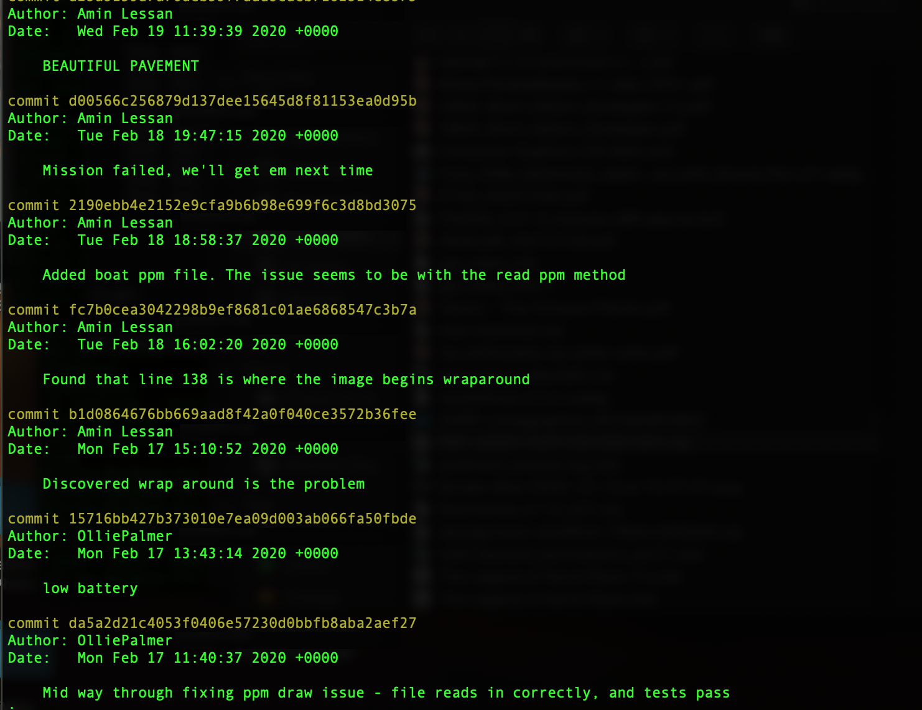

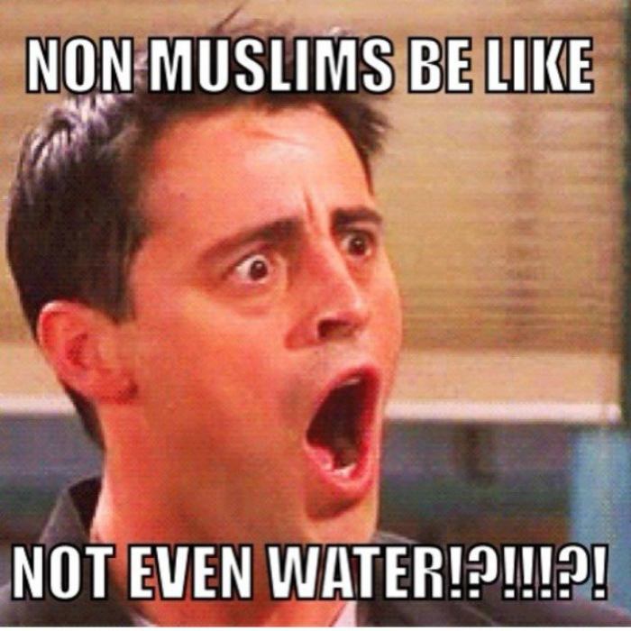
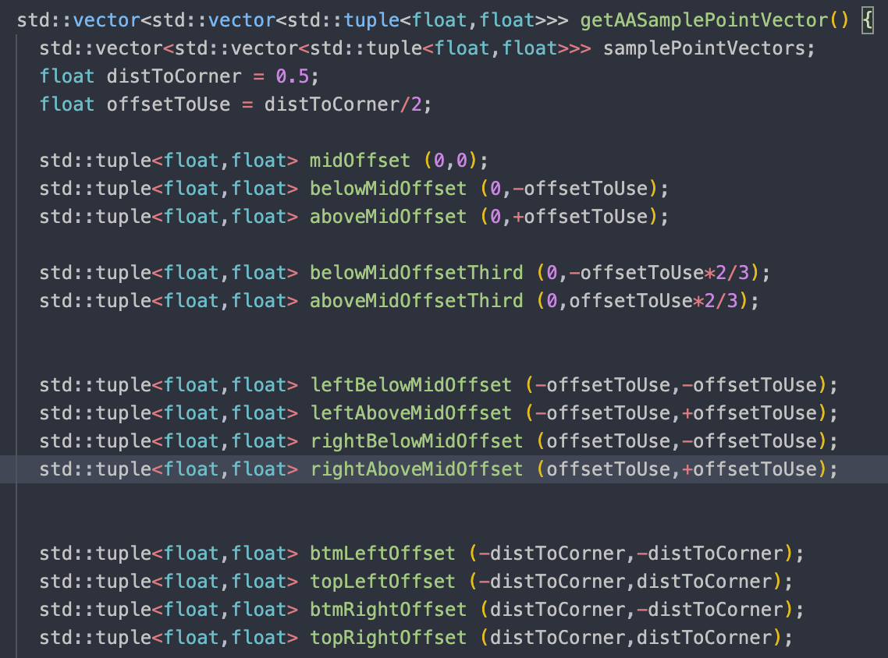
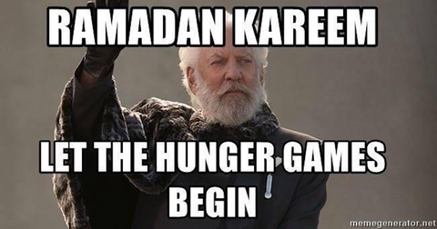
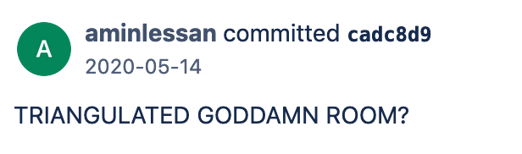
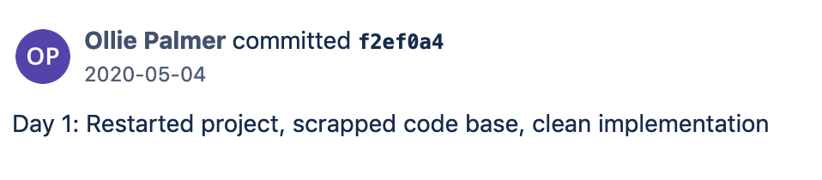
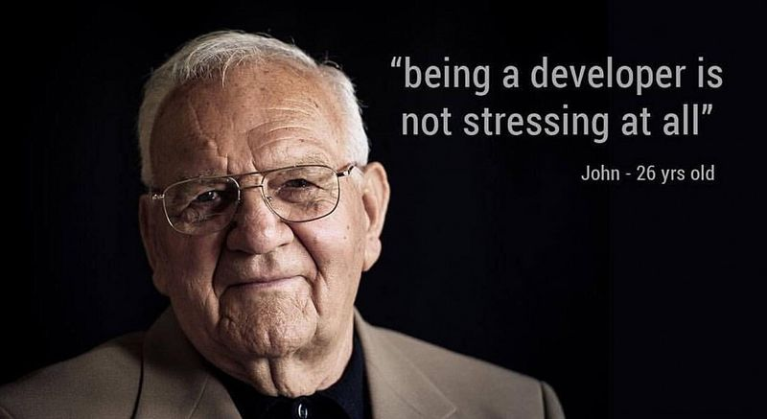

Rule #10 Thou shalt break these rules if necessary.
float currentx1ToTopVertDist = getDistBetweenTwoPoints(…);
/* trivial case of bottom-flat triangle */
float bottomFlatTopToBottomInvSlope … ;

Slide 16
Recap
Thou shalt be specific.
Thou shalt not use unnecessary words.
Thou shalt not use abbreviations.
Thou shalt use the code's primary human language.
Thou shalt not make up words.
Thou shalt not include type.
Thou shalt only use non-obvious words if the meaning is obvious.
Thou shalt prefer active voice.
Thou shalt use consistent syntax.
Thou shalt break these rules if necessary.

Slide 17
Recap of the Recap
Thou shalt be specific when naming variables during software development particularly if the context is hard to determine.
Thou shalt not use unnecessary, superfluous, unneeded or useless words.
TSNUA
Você deve usar a linguagem humana primária do código.
Thou shalt not make up words, this unlightens everyone.
strThou_shalt_not_include_type.
Thou shalt only use esoteric words if the meaning is non-esoteric.
The active voice should be preferred by thee.
Thou shalt, use cOn_Sis-TeN.t syntax!?
You can break these rules if necessary.

Slide 18
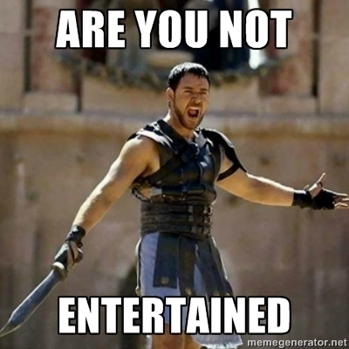
tl;dl;
be consistently ‘concise but specific’
or
why use lot word when few do trick

